Slide 1
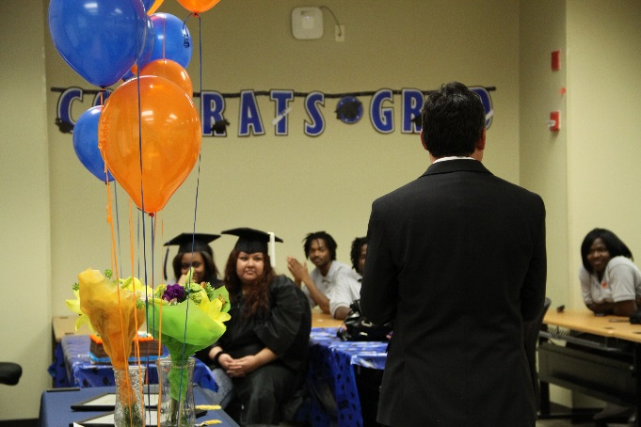
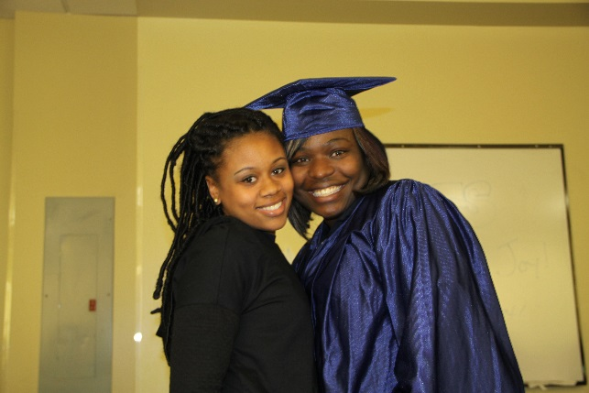

Graduation Ceremony: Preparation
Before Hand:
Diploma: Ask if you graduates would like their diplomas mailed to campus and if so have them request that from COHS. Or, remind them to bring the diploma.
Invitations: Print invites that students can give to family and friends
Refreshments: Order refreshments (e.g cake and/or pizza)
Plan Decorations: Use balloons, Dollar Store Supplies, etc.
Speakers: Ask your DOA or Campus President to prepare a few words and be sure to get the event on their schedule
Have graduate sign media release (see attachment)
Create a program with order of events
Reserve cap and gown
Consider Purchasing tassel /charm for graduate to keep and/or a diploma frame

Slide 2
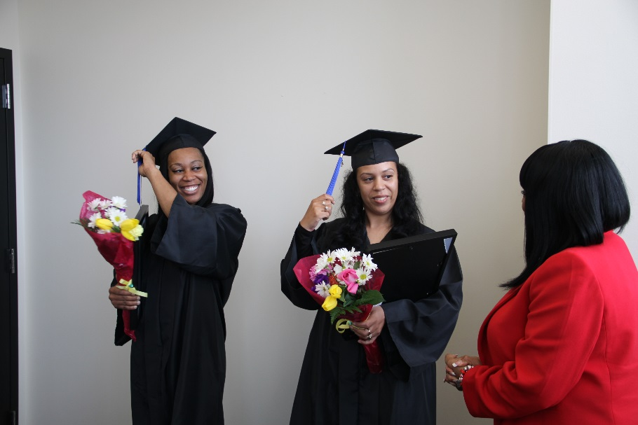
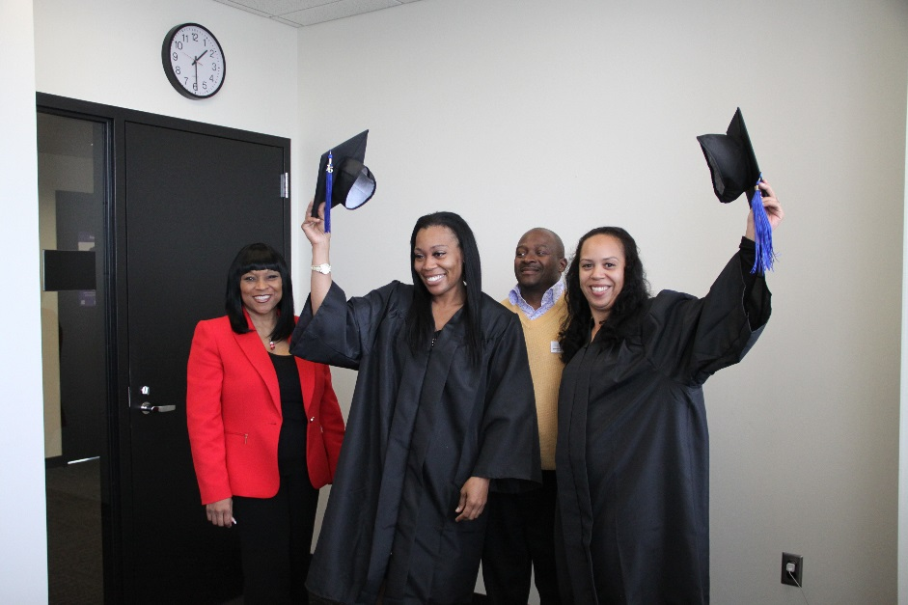
Graduation Ceremony : Event
Invite COHS students who are working to inspire them
Decorate room
Pick up refreshments
Have student process to music (Pomp and Circumstance - see you tube)
Have students dress in cap and gown
Have DOA or campus president say a few words
Present diplomas and/or frames
Take photos of students in gown to share and post on your bulletin board in the learning lab
Give graduate a chance to say a few words
Facilitator can consider saying a few words (read inspiring poem or book such as “Oh the Places You’ll Go.”

