Slide 1

Industry-Recognized Certifications Webinar
August 23rd 2018
Presented by Jesse Shaw and Shannon Clarkson

Slide 2
Webinar Agenda
• What are Industry-Recognized Certifications and why they are so important
• ed2go courses that lead to Industry-Recognized Certifications
• Vouchers and certification exam costs included with many courses
• Tools to help you market these courses
• How to start offering these courses to your community
• Q and A

Slide 3

Industry-Recognized Certifications
What are they and who developed them?
In order to address the skills gap, many business sectors have developed industry-recognized certifications to ensure their workforce is equipped with adequate skills and specialized knowledge. Certifications are often seen as the benchmark needed to enter into and advance in specific industries.

Slide 4

Industry-Recognized Certifications
Why are these Certifications so important to you and your students?
Inherent in these skills credentials is the identification of the knowledge, skills and abilities required in jobs within specific sectors and industries. These nationally portable, standards-based, industry-recognized skills credentials benefit labor market needs and end up being a great value to consumers.
This approach better aligns education and training to career success

Slide 5
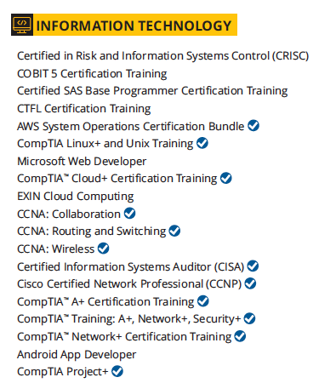
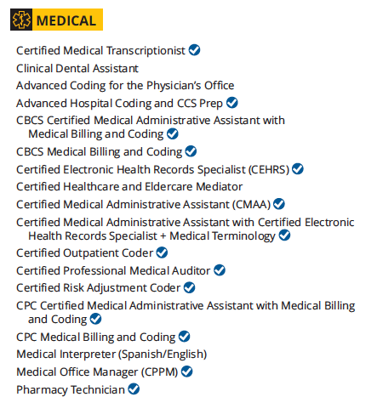
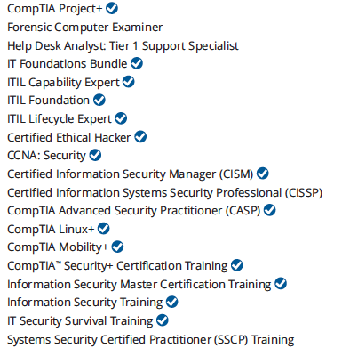

ed2go Courses
ed2go can provide you with many courses
that lead to Industry-Recognized Certifications

Slide 6
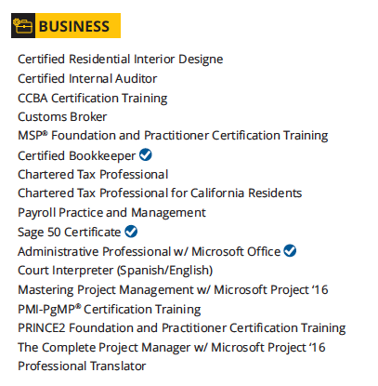
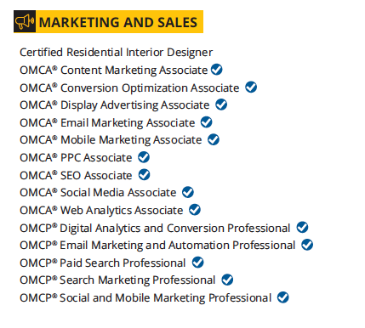
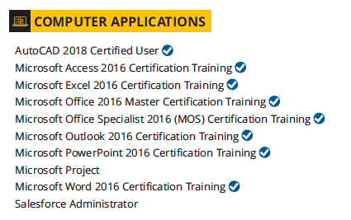
ed2go Courses
ed2go can provide you with many courses
that lead to Industry-Recognized Certifications

Slide 7
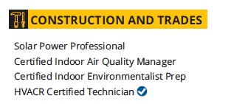
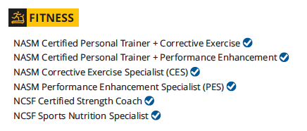
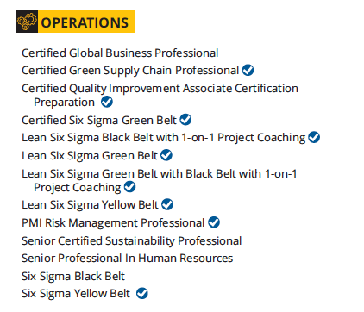
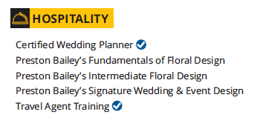
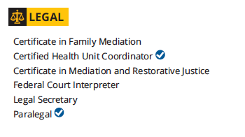
ed2go Courses
ed2go can provide you with many courses
that lead to Industry-Recognized Certifications

Slide 8

Certification Exam Costs
Vouchers and certification
exam costs included with many courses
Certification exam vouchers enable students to save time and money by providing a more streamlined, easy way to take their exam, after their training is complete.
Industry-certifying exam costs are included with an increasing number of courses. Our partner institutions, 3rd party funding sources, and most importantly, students appreciate the all-included package the exam vouchers provide.

Slide 9
Advanced Career Training Courses
Offer these Courses by adding the Advanced Career Training Product Line
Self-paced, start anytime format
Instructor-facilitated
24/7 online access
Books and materials included
Financial assistance available
Student advising and support services
Admissions team can enroll students on your behalf
Only offer the courses that you want
Set your own pricing
Fill in gaps in your catalog • Improve the range of your offerings
Add a higher price revenue stream • Reach more of your community

Slide 10
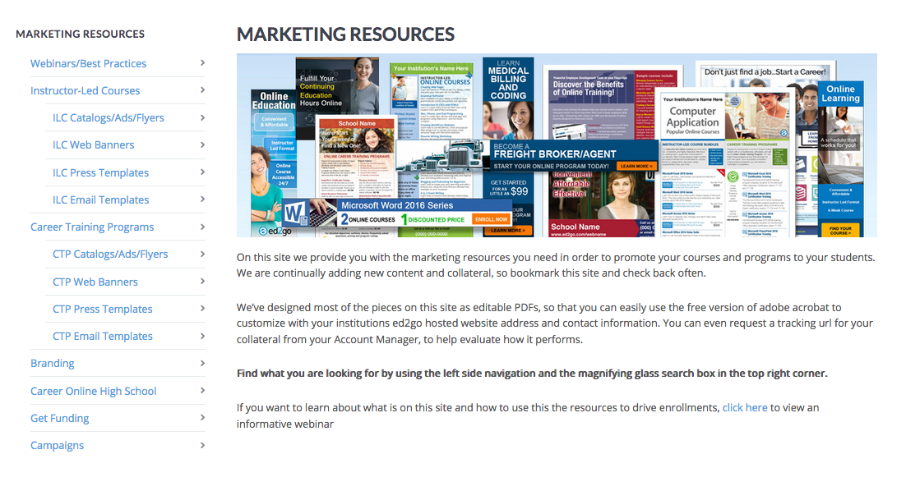
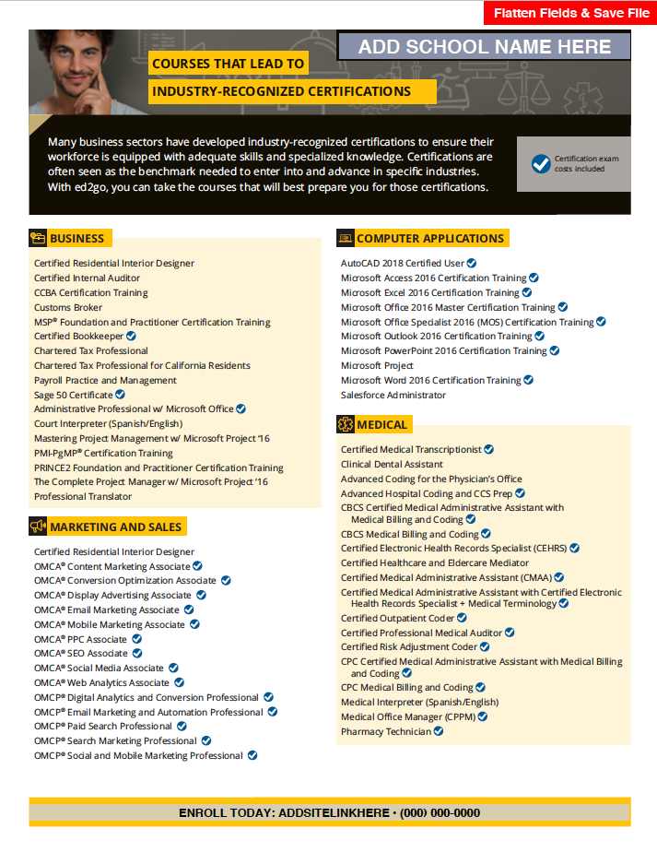
Tools to help market these courses
Once you start offering the Advanced Training Courses, we have tools on the partner marketing site to help you promote them.
partner.ed2go.com/marketing-resources/

Slide 11
Offer these Courses to Your Community
Industry-Recognized Certifications help people find employment. Give your students access to these skills by adding Advanced Career Training Courses to your offerings today.
Your Account Manager will be following up with you about adding these important courses. They can answer any questions you have and help you analyze your local in-demand occupations and the ed2go courses that map to them.
We look forward to connecting with you about these exciting courses

Slide 12

Thank you for Attending
A recording of this webinar and the slides will be available soon on the partner marketing site, under webinars

