Slide 1


Partner Webinar:
Grow Enrollments with February 11, 2021
SEO-Optimized Landing Pages

Slide 2

Today's Presenters
Daniel Vopat
ed2go Senior Regional
Account Manager
Jesse Shaw
ed2go Partner
Marketing Manager
Anna Go
Program Coordinator
Houston Community College
www.ed2go.com

Slide 3


Our Agenda
1
2
Partner Website Evaluation Project
Course-Specific Landing Pages
3
4
Houston Community College Success Story
Q&A and Next Steps
www.ed2go.com

Slide 4
Goals of this Webinar
We are going to show you how you can easily:
Increase enrollments​
Increase website traffic
Improve search engine rankings for courses
Make it easier for students to find online courses on your website
www.ed2go.com

Slide 5
The Background
Knowing your website is a powerful marketing tool, ed2go conducted a research project to better understand what levers help drive enrollments on our partners’ .edu websites.
Visceral look and feel
Behavioral Function
Visual Aesthetics
Are the visuals consistent, compelling, meaningful?
Intuitive, Accessible
Is the site easy to use and accessibility compliant?
Is the interface unobtrusive?
ed2go Branding
Is it present? Is it contextually relevant?
Integrated Experience
Does the presentation of ed2go courses feel like it’s part of the site, or a disconnected experience?
Vendor Differentiation
Are multiple vendors present?
How are they differentiated?
Catalog Visibility/Product Differentiation
Are ed2go courses easy to find?
Expertise, Authority, Trust (E.A.T.)
Are E.A.T. factors present?
Are they well-executed?
Metadata and Schema
Are SEO optimizations present and well-executed?
www.ed2go.com

Slide 6
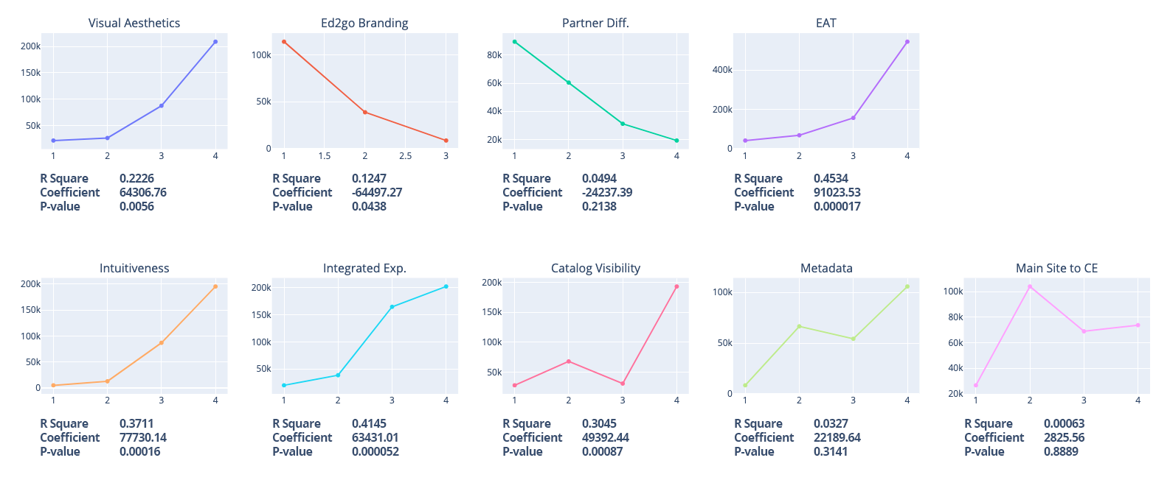
The Outcomes
Average Revenue by Ratings
www.ed2go.com

Slide 7



SEO Play - Course-Specific Landing Pages
Create individual course landing pages on your website.
Highlight Advanced Career Training courses that prepare learners for in-demand jobs in your community. We’ll provide the local job data to help you decide on the courses you want to feature.
Top Career Training courses include:
Pharmacy Technician
Freight Broker/Agent Training
Medical Billing and Coding
CompTIA A+ Certification Training
Certified Paralegal
Certified Clinical Medical Assistant (CCMA)
Certified Physical Therapy Aide
Clinical Dental Assistant
Veterinary Assistant
NASM Certified Personal Trainer
Human Resources Professional
www.ed2go.com

Slide 8
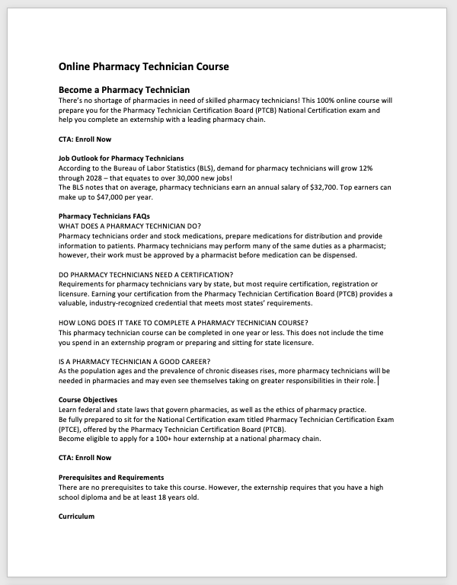


How We Help Build the Landing Pages
Our UI/UX designers, copywriters, and SEO experts have built out assets for you to use to build your page.
What we provide: ​
SEO-rich text
Course Images
Certification logos
Enroll Now links
SEO guidelines
Website evaluation for placement
PDF reference design
The success of this initiative is ultimately dependent on you making the pages look and function like the rest of your website.
www.ed2go.com

Slide 9



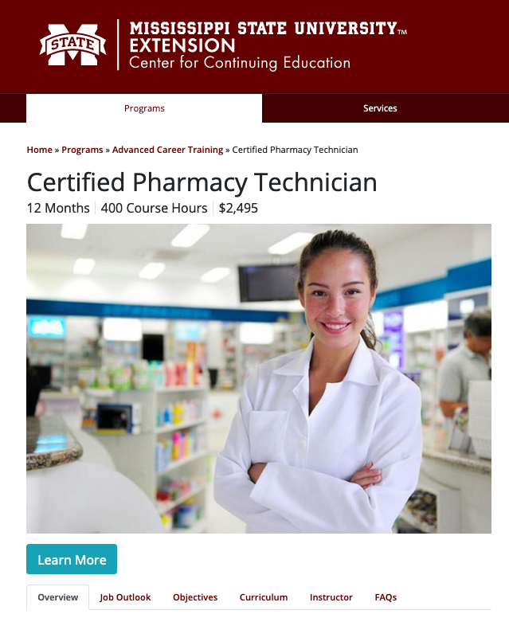

A Few Examples
Mississippi State University
www.ed2go.com

Slide 10

Partner Success Story – Houston Community College
Introducing Anna Go
Landing page implementation Process for HCC
Introduction to initiative
Deciding on the courses
Bringing in HCC centralized marketing team
ed2go team website audit and suggestions
Building of entry page and landing pages
Email marketing
HCC Online Continuing Education Site
www.ed2go.com

Slide 11
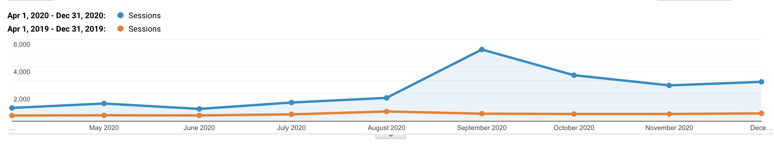
Houston Community College Results
HCC has seen a 337% increase in referral traffic to their ed2go-hosted site since standing up their course landing pages with a 275% YOY enrollment growth
www.ed2go.com

Slide 12

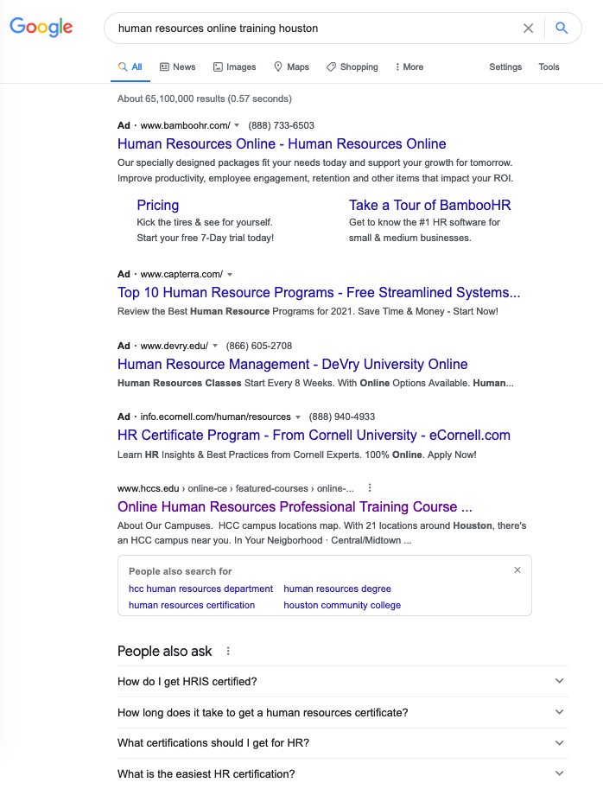
The Proof: SEO
HCC's new landing page is already the #1 non-paid search result for Houston area search terms.
Once created, these course-specific landing pages begin ranking high on Google and other search engines.
www.ed2go.com
Notes:
Of if you google freight broker training Lubbock, the new landing page and hosted site show up in the first two search results.
Try “Freight Broker Training Des Moines” or “Pharmacy Technician Online Des Moines” – Also showing up at the top of search results

Slide 13
The Benefits to Your Website
Standing up course-specific landing pages can boost your website
Increase enrollments and make up lost revenue from campus closures and increased online demand​
Make it easier for students to find these online courses with a more integrated experience
Improve search engine rankings for your website and promote trustworthiness
Align with workforce initiatives and economic recovery in your community
No additional cost
www.ed2go.com

Slide 14
Next Steps
Here are the next steps to get started or to add more pages:
Work with your Account Manager to decide on the courses you want to feature
ed2go creates the assets for your pages (links, photos, SEO text)
Implementation call to review the assets and recommended website placement
ed2go sends the assets
Using provided assets, you build the landing pages on your site
ed2go is available to answer any questions
www.ed2go.com

Slide 15
Q and A
Questions and Answers
www.ed2go.com

Slide 16
Thank You
For Attending our Webinar
Contact your Account Manager Today to get started!

