Slide 1

The Fast Track to an In-Demand
Career:
ed2go’s New & Improved
Medical Billing and Coding Course
April 8th, 2021

Slide 2



The Fast Track to an In-Demand Career:
ed2go’s New & Improved Medical Billing and Coding Course
April 8th, 2021
Lesli Beavers
Director of Workforce
Clark State College
Shannon Clarkson Product Manager ed2go
Audrey Wyrick
Sr. Product Marketing Manager ed2go

Slide 3
Agenda
ed2go, who we are
The ed2go Ecosystem
Growing industry demand for Medical Billing & Coding
New & improved Medical Billing & Coding and Medical Assisting courses
Marketing resources
Q&A

Slide 4
Student Focused Approach
We exist to enrich the lives of students, equipping them with relevant and transferable skills. All while providing Partner institutions the expertise and support they need to ensure their students’ success.
Online format effectively serves individuals with barriers to training and teaches all learners to use technology effectively
Portable and stackable training courses
One-on-one support and monitoring from a dedicated Student Advisor throughout their course
Well-trained instructors and quality curriculum that leads to industry-recognized credentials for regionally in-demand occupations
Training for in-demand occupations
Funding Support – Vocational Rehabilitation services, Workforce Innovation and Opportunity Act (WIOA), grants, military funding

Slide 5








ed2go Ecosystem
Deliver Ready-to-Go Online Courses
900+ courses that align with in-demand occupations
Advanced Career Training and certifications
Fundamentals for soft skill development and employability
Build Your eCommerce
Customized site with your branding
Your choice of courses and retail pricing in your catalog
Online eCommerce and offline payment options
API and single sign-on (SSO) capabilities
Enroll Students
Dedicated enrollment team for advising, course registration, and confirmation
Phone, chat, and email support
Evaluate Local Job Demand Analysis
Continuous, personalized reporting on local workforce demand and student progress
Provide 3rd Party Funding
Identify and secure funding sources and enable access from WIOWA, to MyCAA, state & federal grants and more
Grow with Marketing Support
Customizable marketing assets
Search engine optimization
Embedded lead generation
Partner Services:
Dedicated Account Manager and Marketing Manager to ensure your success
Student Services:
1-to-1 student advisors provide support, career advice, and answer questions
Administer drop, refund, and transfer requests

Slide 6
Industry Insights
Medical Billing & Coding

Slide 7
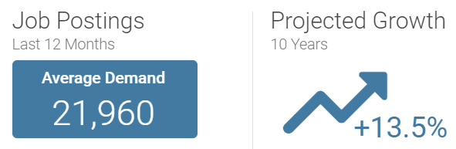
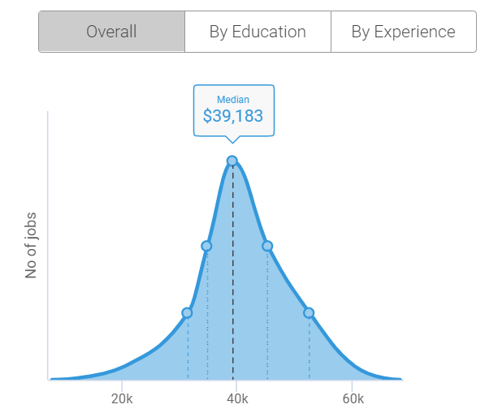
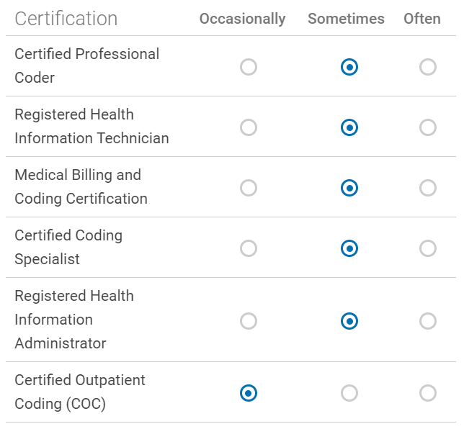
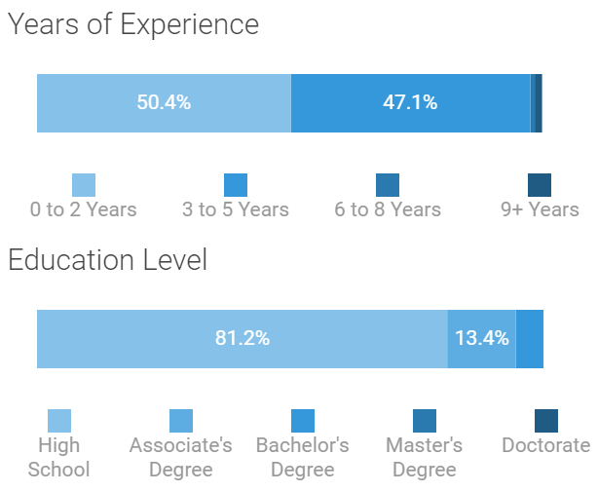
National Job Data*| Medical Coder
Metrics:
Salary:
Requested Certifications:
Qualifications:
*Source: Burning Glass 1/25/2021

Slide 8
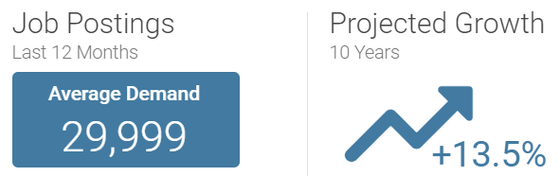
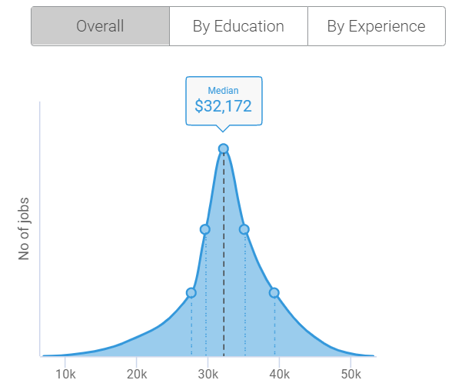
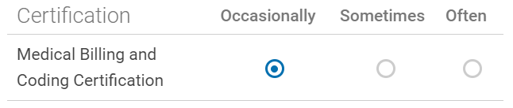
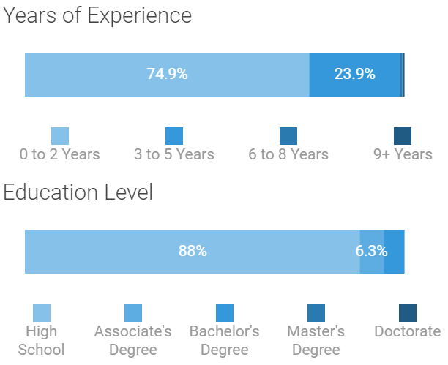
National Job Data*| Medical Biller
Metrics:
Salary:
Requested Certifications:
Qualifications:
*Source: Burning Glass 1/25/2021

Slide 9
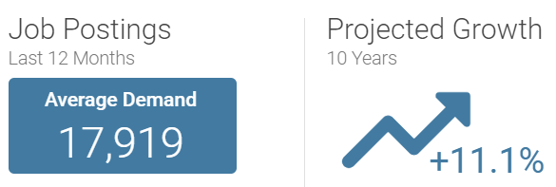
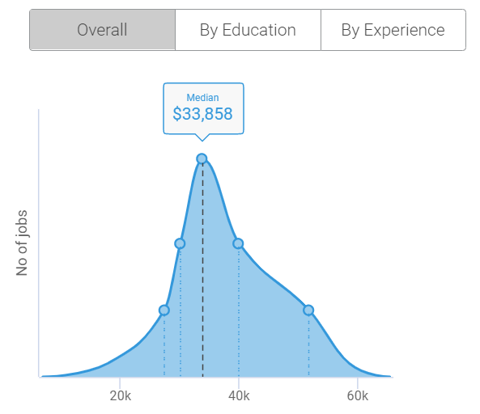
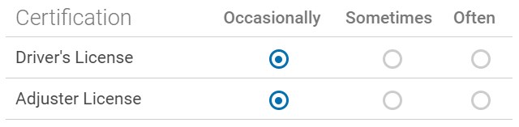

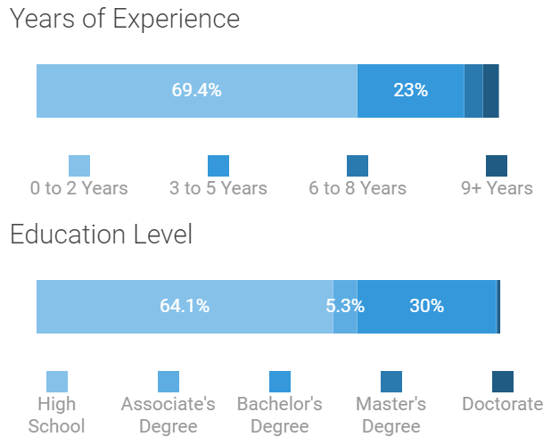
National Job Data*| Health/Medical Insurance Specialist
Metrics:
Salary:
Requested Certifications:
Qualifications:
*Source: Burning Glass (Insurance Claims/Policy Clerk) 1/25/2021

Slide 10



Medical Billing and Coding| MBC
Choice of Certification Voucher and Assets: CPC, CCA, CBCS
Certified Professional
Coder (CPC)
Certified Coding
Associate (CCA)
Certified Billing and Coding Specialist (CBCS)
Become a certified medical coder by earning your Certified Professional Coder (CPC®) credential, the most recognized medical coding certification in the healthcare industry. The CPC is the gold standard for medical coding in physician office settings. Over 105,000 certified professionals help maintain compliance and profitability within medical practices through accurate medical coding and documentation.
                A CPC designation must have at least two years medical coding experience.
      Successful completion of ed2go Medical Billing and Coding course, along with completion of included CPC Practicode will satisfy the experience requirement.
Coding professionals who hold the CCA credential have demonstrated coding competency across all settings, including hospitals and physician practices.
Since 2002, the CCA designation has been a nationally recognized standard of achievement in the health information management (HIM) field .
CCAs:
Exhibit a level of commitment, competency, and professional capability that is valued by employers.
Demonstrate a commitment to the coding profession.
Distinguish themselves from others as having passed AHIMA’s rigorous CCA exam..
Individuals with a CBCS certification from NHA gain access to the knowledge and training they need to prepare for a rewarding and meaningful career as a sought-after Billing & Coding Specialist.
As a CBCS, you may perform some or all of the following tasks:
Gather/review essential patient information
Verify required documentation before patient information is released
Prevent fraud/abuse by auditing billing
Support coding and billing process
Assign codes for diagnoses and procedures
Submit claims for reimbursement
Coach healthcare providers to achieve optimal reimbursement

Slide 11
Content Development and Design
Our Philosophy and Approach

Slide 12
Content Development | Our Design Philosophy
All design and delivery practices are guided by our Four Core Learning Principles
Intentionality | An intentional learning design ensures that a learning experience will be effective and that learners will be consistently challenges without being overwhelmed.
Inclusivity | Content creators consider the full range of human diversity and difference with respect to culture, gender, age, language, abilities, experiences, etc.
Authenticity | Authentic learning design connects what students are learning to the key contexts where it will be used.
Personalization | Personalized learning content recognizes that every learner is an individual. Personalization matters because learners’ success matters.

Slide 13
Content Development | Learning Design Plan
Learning Strategy
Course Structure
Course Build
Define the Learners
Learner Problem
Quality of Learning
Research
Assessment Strategy
How to Build
Organization
Sequence
Tagging Objectives
Modes of Delivery
Wireframes
Content Audit
Risk Assessment
Features
Schedule & Budget
All ed2go courses are built using Backwards Design -- all content and assessments are mapped to a robust learning objective hierarchy.
4

Slide 14

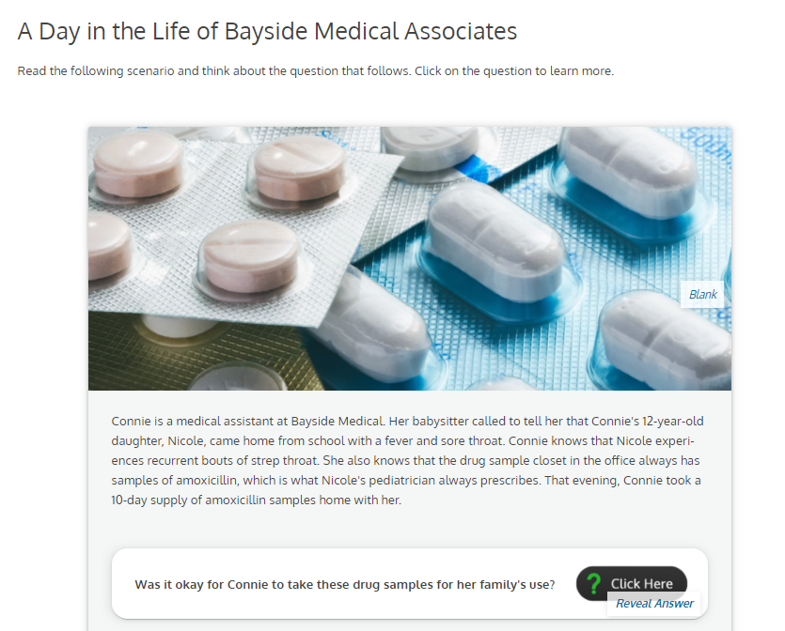
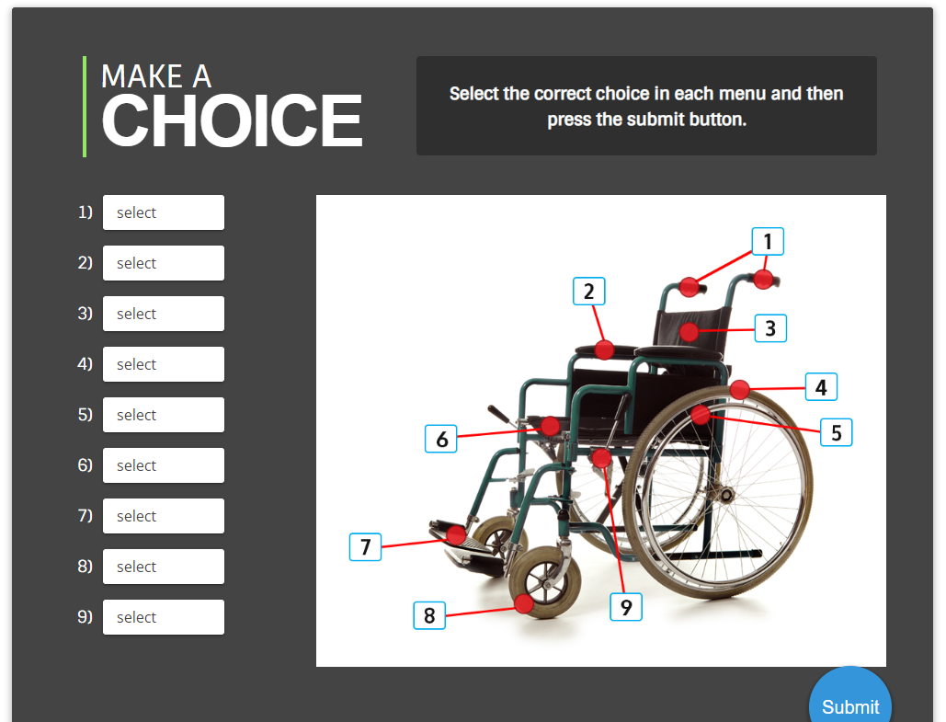
Content Development | Course Features
Our courses are designed to facilitate learning comprehension and are composed of multimedia modes to best achieve this goal.
Sample of Course Elements:
Objective-Driven
Narrative
Case Studies/PBL
Self-Check Interactives and Simulations
Audio and Video components
Stimulating Images and Diagrams
Real-World Applications
Safe-to-Fail Assessments
Accessible

Slide 15

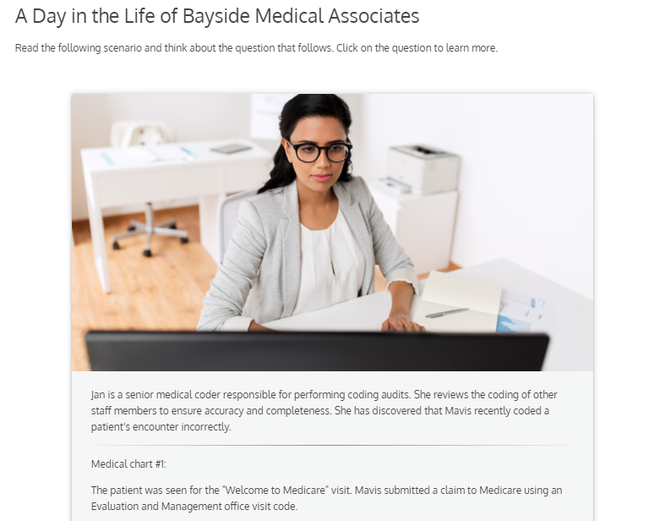
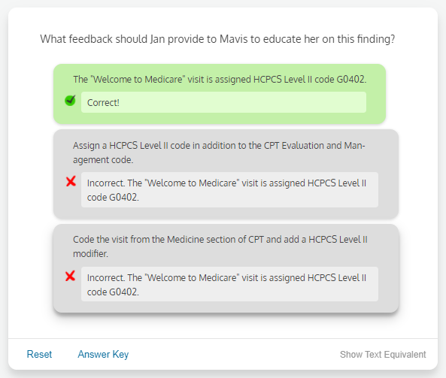
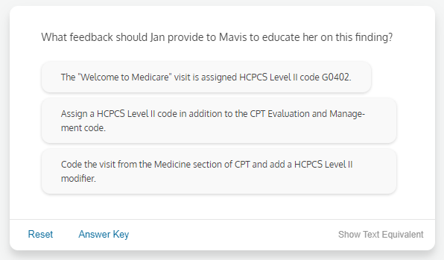

Medical Billing and Coding | MBC
Reality Checks / Revisited

Slide 16
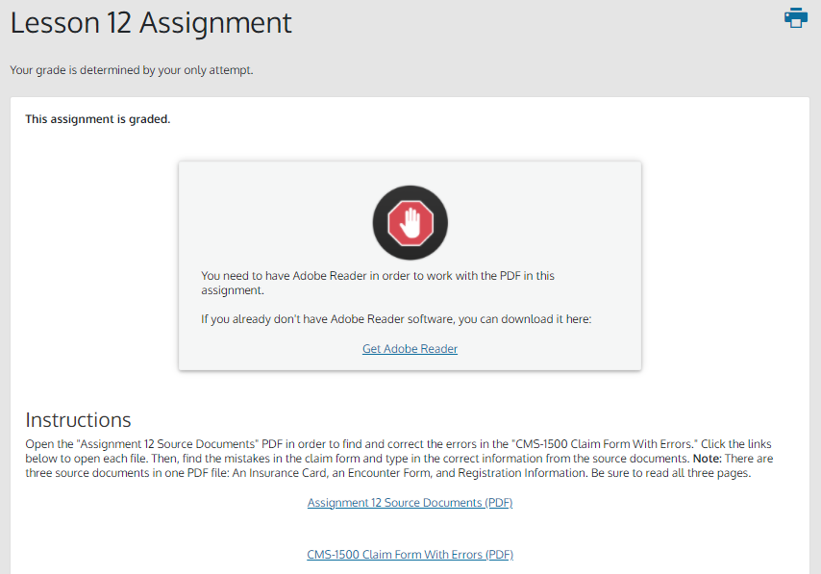
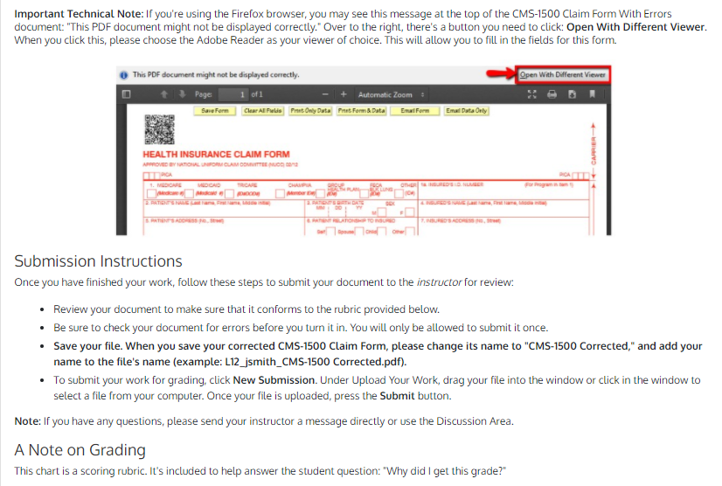
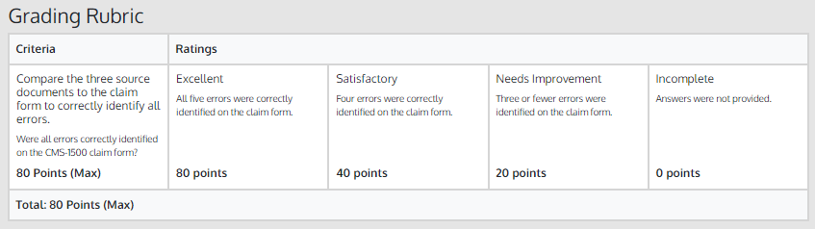
Medical Billing and Coding | MBC
Industry-Based Assignments/Projects (Graded)

Slide 17
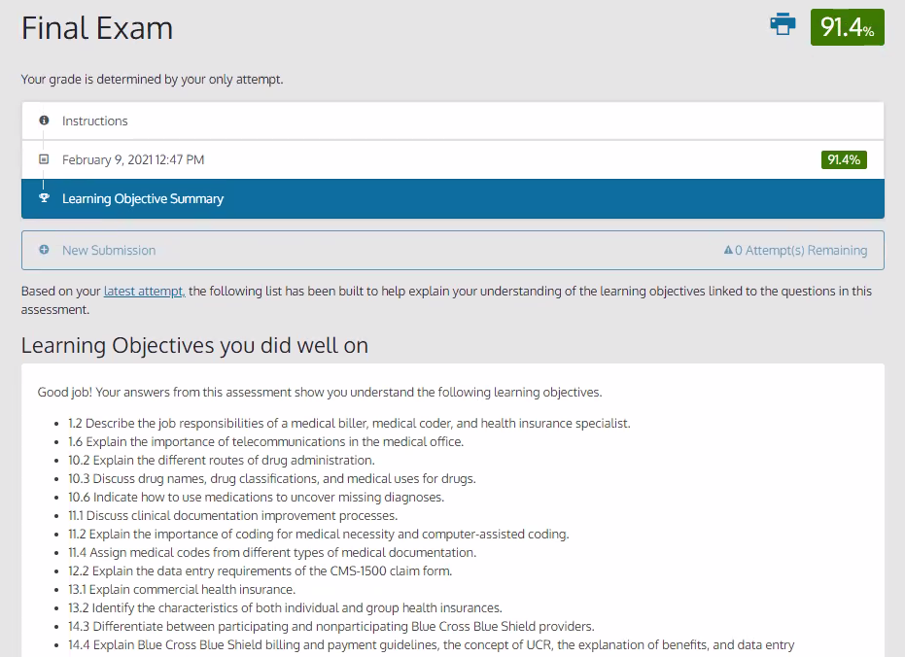
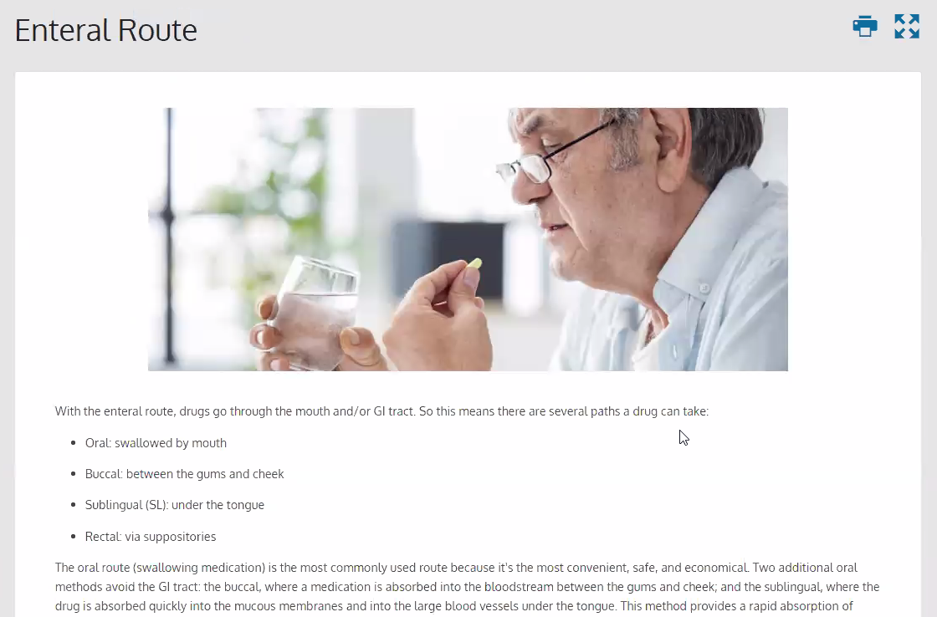
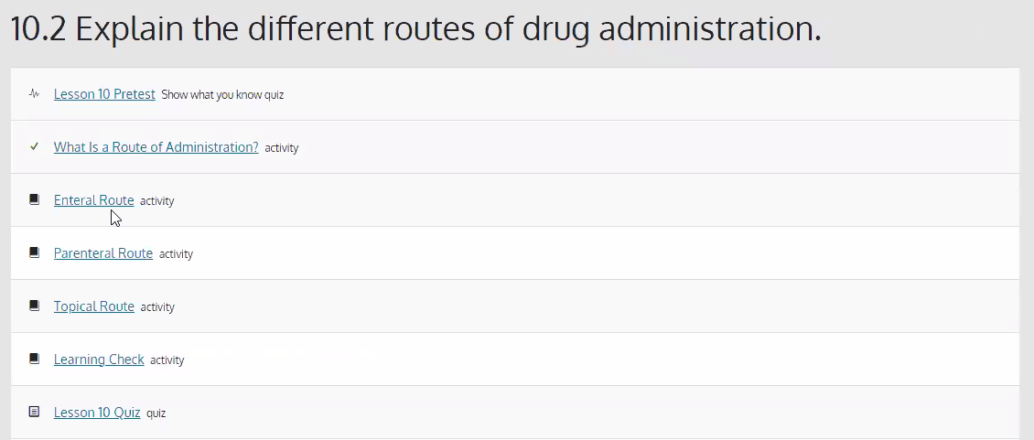
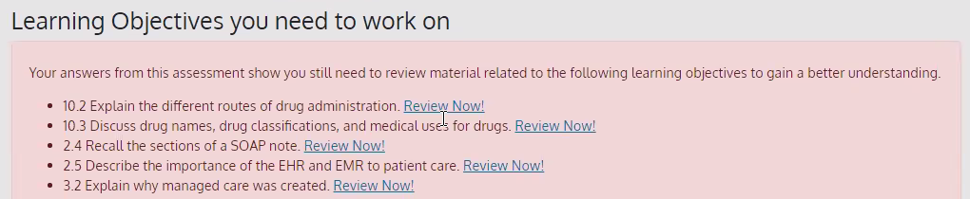
Medical Billing and Coding | MBC
Assessments (with feedback and remediation)

Slide 18


Medical Billing and Coding| MBC
Certification Voucher Packages: CPC, CCA, or CBCS
Certified Professional
Coder (CPC)
Certified Coding
Associate (CCA)
Certified Billing and Coding Specialist (CBCS)
Included in ed2go Tuition:
                Certified Professional Coder (CPC) Exam Voucher
              One free retake if taken at testing center
              $199 re-take fee for online proctored
                1-year membership to AAPC
                CPC Study Guide
                CPC Exam Review
              Online, self-paced course
                CPC PractiCode
              Qualifies as 1-year work experience
                CPC Practice Exam Bundle
Included in ed2go Tuition:
Certified Coding Associate (CCA) Exam Voucher
AHIMA Membership
PAC Professional Review Guide for the CCA Examination
Included in ed2go Tuition:
Certified Billing and Coding Specialist (CBCS) Exam Voucher
CBCS Online Study Guide
CBCS Practice Exams

Slide 19


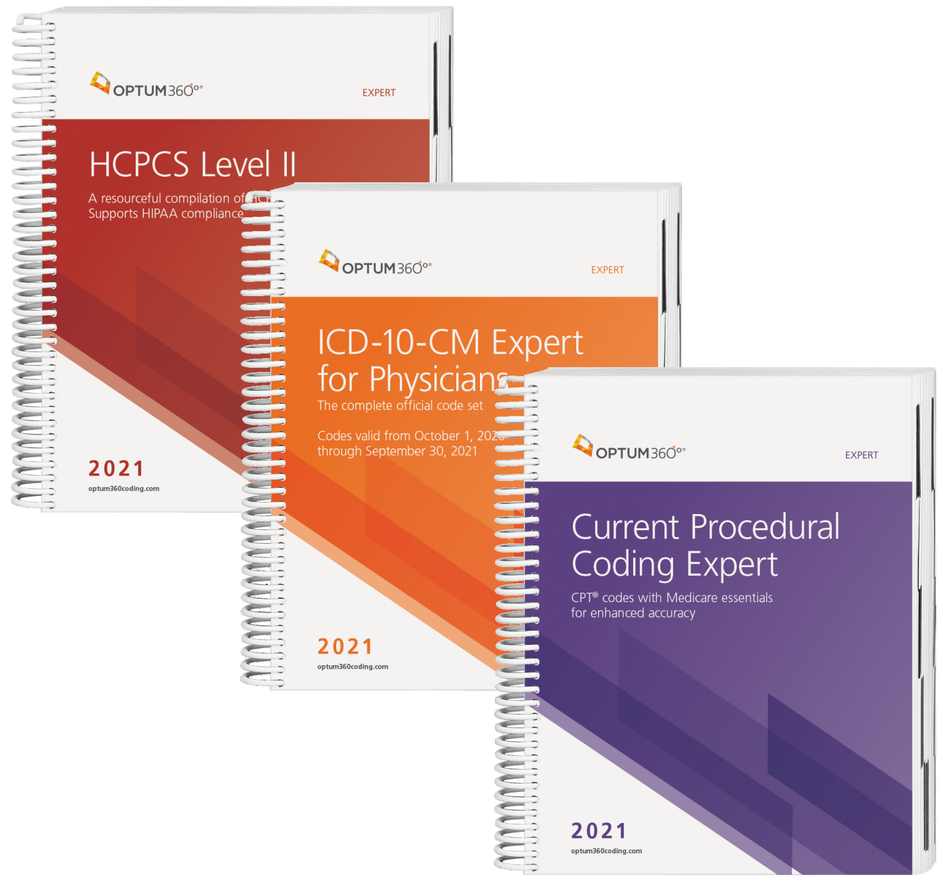
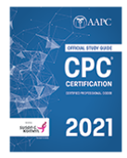
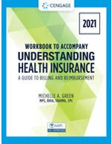

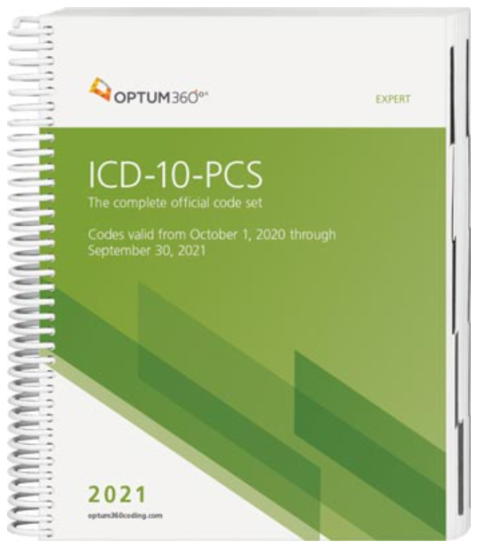

Medical Billing and Coding | MBC
Materials Shipped to Learners
Core Textbooks
Required for Certification Exams
Based on Certification Choice

Slide 20

www.clarkstate.edu
Springfield/Dayton, Ohio Regional MBC & MA data from JobsEQ
  66 Current job postings in our four-county region
  1.3% Annual Growth outlook
  CPC most in-demand certification in our region
ed2go Partnership Benefits
  Marketing assistance through assets
  Pros of engaging
Marketing Campaigns
  E-blasts
  Facebook marketing
Funding/Student Services
  WIOA
  Remote learning assistance

Slide 21

Marketing Resources

Slide 22

Partner Marketing site
Dedicated Partner Marketing site includes:
Marketing plans
Campaigns-in-a-box
Collateral – flyers, brochures, catalogs, email templates, banner ads
Press releases
Social media content
Best practices
***All MBC and MA collateral is updated with the new course content
Bookmark the Partner Marketing Site
www.partner.ed2go.com
www.ed2go.com

Slide 23
Q&A

Slide 24

THANK YOU
FOR ATTENDING
CONTACT US
Ed2go.marketing@Cengage.com

Slide 25
Appendix

Slide 26
MBC 2021 | Certifications At a Glance
Certification Options Included
Certifying Body | AAPC | AHIMA | NHA
Exam | CPC/CPC-A | CCA | CBCS
Website | AAPC Certification | AHIMA Certification | NHA Certification
Type of Certification | Physician-based (professional fee) medical coding national certification | Medical coding national certification for physician practices and hospitals | CBCS thru 6/21: Medical billing national certification for physician practices CBCS starting 7/21: Medical coding and reimbursement national certification for physician practices.
Prerequisites | Completion of Medical Billing and Coding course, high school diploma or GED | Completion of Medical Billing and Coding course, high school diploma or GED | Completion of Medical Billing and Coding course, high school diploma or GED
Included in Voucher Package | 1-year membership to AAPC CPC Exam Voucher one free re-take if needed if at testing center; $199 retake fee if online proctored) CPC Exam Review course CPC Study Guide PractiCode (online practicum program) CPC Practice Exams | CCA Voucher PAC Professional Review Guide for the CCA Examination AHIMA Membership | CBCS Exam Voucher CBCS Online Study Guide CBCS Practice Exam
Additional Information | The CPC is the most popular certification in the coding field. Those who pass the CPC will be designated as an Apprentice (CPC-A) on their certificate. Removal of the apprentice status is accomplished by 2 years of on-the-job experience. Successful completion of this course will quality student for removal of 1 year, and completion of PractiCode (included) satisfies the remaining year requirement. | The CCA is thought to be more difficult than the CPC and includes Inpatient (ICD-PCS) Coding and Reimbursement Methodologies. | The CBCS may be more or less familiar to employers based on your region. CBCS thru 6/21: No Medical Coding CBCS starting 7/21: Basic Medical Coding + Outpatient Reimbursement

Slide 27
MBC 2021 | Certification Exam Coverage Comp
Exam Coverage
Topic/Details | CPC/CPC-A Exam | CCA Exam | CBCS Exam
 |  |  | Ends June 30th, 2021 | Starts July 1st, 2021
Billing (claims processing, insurances, ABN) | No | No | Yes | Yes
Coding: In-Patient | No | Yes | No | No
Coding: Out-Patient | Yes | Yes | No | Yes
ICD-10-CM | Yes | Yes | No | Yes
ICD-10-PCS (Basic) | No | Yes | No | No
HCPCS Level II | Yes | Yes | No | Yes
CPT | Yes | Yes | No | Yes
Medical Terminology (including Anatomy & Physiology) | Yes | Yes | Yes | Yes
Reimbursement Methodologies: Inpatient and Outpatient (DRGs, APCs) | No | Yes | No | No - IP Yes - OP
Health Records and Data Content | No | Yes | No | Yes
Privacy and Confidentiality | Yes | Yes | Yes | Yes
Number of Questions | 150 multiple-choice questions | Approximately 100 multiple-choice questions | 100 multiple-choice questions (scored) 20-25 pretest (not scored)
Exam Format | Computer-based exam in proctored setting | Computer-based exam in proctored setting | Computer-based exam in proctored setting
Exam Length | 5 hours, 40 minutes | 2 hours | 2 hours | 3 hours
Code Books Required | ICD-10-CM, CPT, HCPCS Level II | ICD-10-CM, ICD-10-PCS, CPT | None | ICD10-CM, CPT, HCPCS Level II
Continuing Education Units Required | Yes | Yes | Yes | Yes

Slide 28
Content Development | Our Design Philosophy
All design and delivery practices are guided by our Four Core Learning Principles:
Intentionality | An intentional learning design ensures that a learning experience will be effective and that learners will be consistently challenged without being overwhelmed. | Every element has a purpose. Nothing is “just there.” The objectives are defined first (backward design). Assets, activities, and assessments are created and sequenced to help the learner achieve those objectives.
Inclusivity | Content creators consider the full range of human diversity and difference with respect to culture, gender, age, language, abilities, experiences, etc. | Inclusive content recognizes the full range of learners’ diversity with respect to culture, gender, age, language, abilities, and experiences. Accessibility is part of—but not all of—inclusivity. We use the Universal Design for Learning framework to create options for how we engage learners, present information, and ask learners to demonstrate what they know.
Authenticity | Authentic learning design connects what students are learning to the key contexts where it will be used. | Authentic content is related to how the discipline is enacted in the real world; authentic activities ask the learner to do what they would be asked to do in the world. Authenticity involves real-world tasks and problem solving, social learning, and opportunities to reflect on connections between learning activities and the real world.
Personalization | Personalized learning content recognizes that every learner is an individual. Personalization matters because learners’ success matters. | This involves meeting the individual learner’s needs for competence, autonomy, and belonging. Personalized content includes formative assessments, choices in learning activities, timely and targeted feedback, chunked readings, and opportunities for interactions among learners/instructors.

