Slide 1


Unlocking Grant Success:
Expert Tips and Strategies
September 24, 2024 – 12:00-12:45 EST

Slide 2



Slide 3
Agenda
Introduction
First Steps to Consider
Understanding Your Institution’s Resources
Building Local Connections
How ed2go Can Help
Action to Impact, A Grants Conversation with ed2go Partner Tifarah Pardue, FGCU
Questions

Slide 4




Unlocking Grant Success: Expert Tips and Strategies
Tifarah Pardue
Director of Continuing Education and Innovation
Florida Gulf Coast University
Christy Brammer
Grant Specialist
ed2go
Juanita Soranno
Head of Impact
ed2go
Clark Crowell
Director, Academic Channel
ed2go

Slide 5
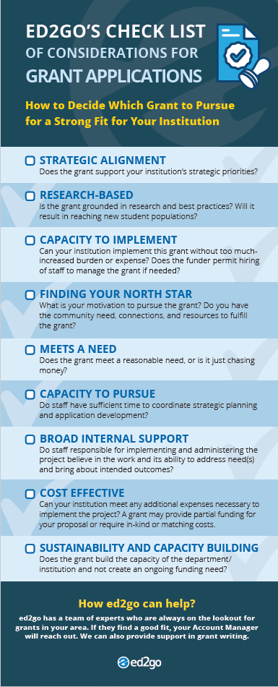

First Steps to Consider
Kick Off Your Grant Process
Pinpoint a need in your community that could be addressed with a grant funded program
Identify other organizations in your community you could partner with to meet the goals of your program
Evaluate your courses to determine if they can meet the need you pinpointed
Screen shot of the takeaway deliverable

Slide 6
Understanding Your Institution’s Resources
Connect with Your Institution’s:
01
02
03
Grants Department Office of Sponsored projects
College Foundation or Foundation Relations Department
Institutional Research Department

Slide 7
Identifying and Securing Grants
How ed2go can help with the grant process
ed2go can:
Serve as a research engine
Assist with application drafts, feedback, or budget construction
Recommend ways our courses can be used in innovative ways

Slide 8

Building Local Connections
Build networks and alliances
Encourage Collective Action
Bring together individuals from different backgrounds, cultures, disciplines and experiences.
Solving complex societal challenges
Strengthen Networks & Alliances
Diversity Enriches Problem Solving
Leading to innovative and holistic solutions
Providing a knowledge-sharing collaboration with greater efficiency

Slide 9
Understanding our Impact
Isolated Impact
Collective Impact
Funders select individual grantees that offer the most promising solutions
Institutions work separately and compete to produce the greatest independent impact
Evaluation attempts to isolate a particular organization’s impact
Corporate and government sectors are often disconnected from the efforts of academic institutions, foundations and nonprofits
Progress depends on working toward the same goal and measuring the same things
Large scale impact depends on increasing cross-sector alignment and learning among organizations
Corporate, CBOs, and government sectors are essential partners
Organizations actively coordinate their actions and share lessons learned
ed2go can help drive this effort with you

Slide 10
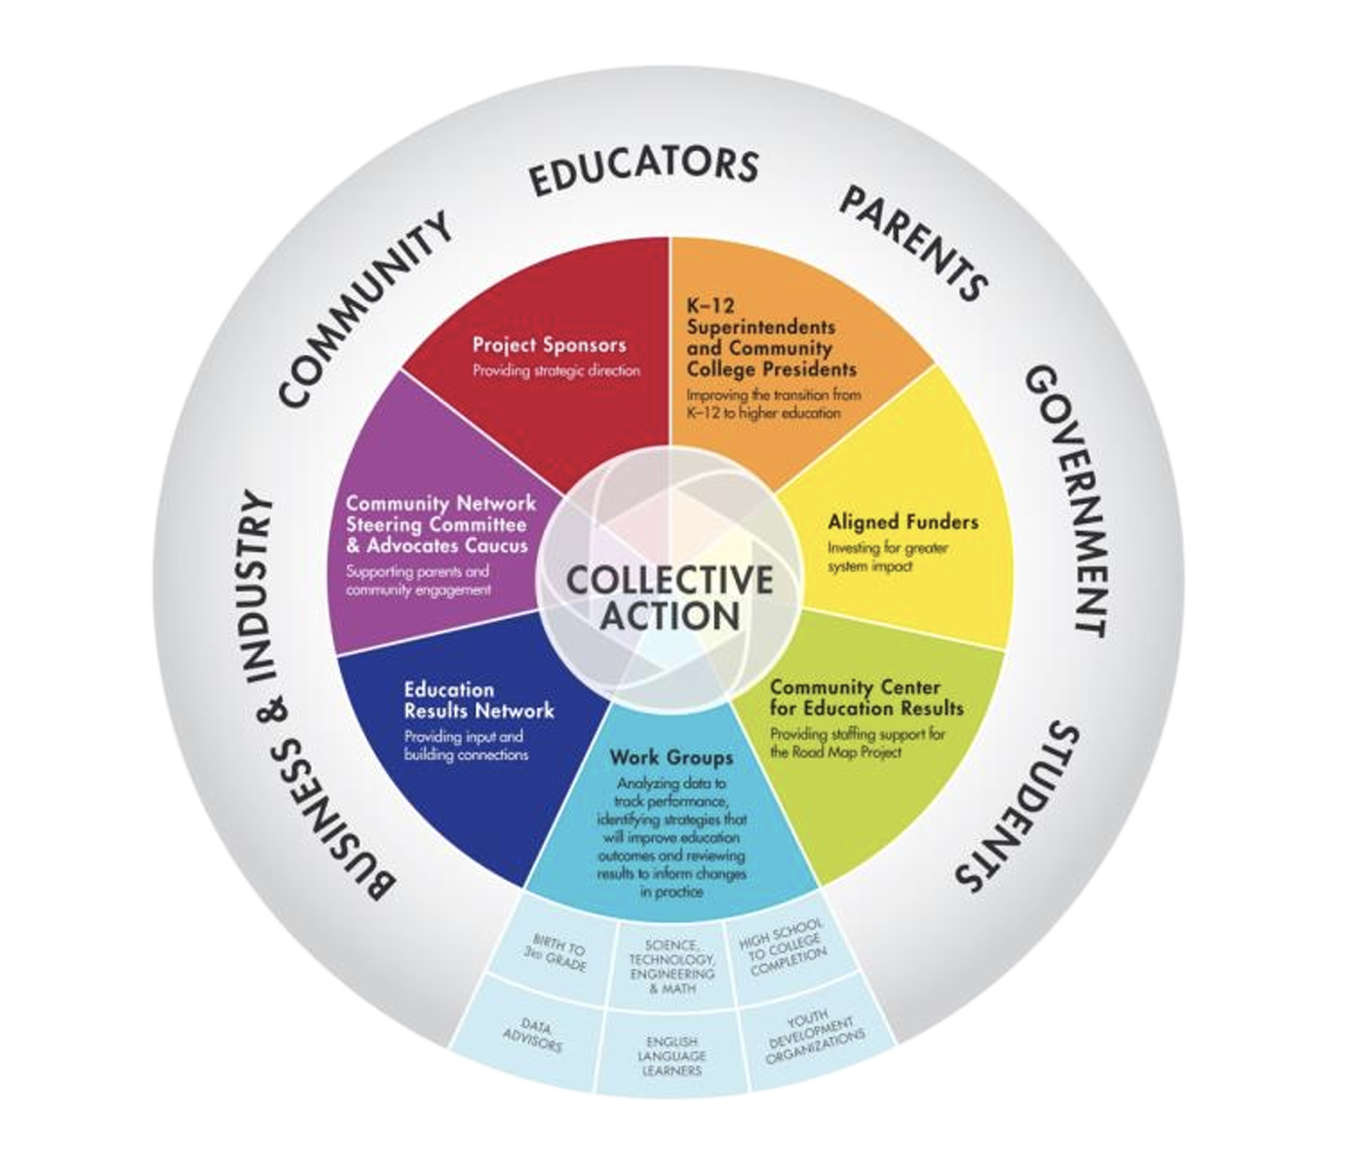

When individuals, communities, organizations and governments unite towards a common goal, the combined strength and resources create a multiplier effect; thus, amplifying the impact.
World Economic Forum
Discovery Weeks & Asset Mapping with ed2go

Slide 11
Action to Impact:
A Grants Conversation
with Tifarah Pardue, FGCU
&
Clark Crowell, ed2go

Slide 12
Questions?

Slide 13
Thank you

